Slide 1
Notes
This presentation is for workshop ‘Protect your IoT Fleet’
Latest update: March 2020 by phamh@

Slide 2
Resources/ References
CIS Controls Internet of Things Companion Guide V7.1
AWS IoT Security document
Ten security golden rules for IoT Solutions

Slide 3
Protect your IoT fleet
Presenter
Date

Slide 4
Agenda
Intro
Challenges with protecting IoT devices at scale
Security strategy for IoT Solutions
Module 1: Environment Setup (15 min)
Module 2: Audit your IoT Fleet (30 min)
Module 3: Detect compromised devices using Cloud-side metrics (and presentation) (45 min)
Module 4: Detect compromised devices using Device-side metrics (30 min)
Clean up

Slide 5
Challenges with protecting IoT Devices
Variety of suppliers/vendors
Device has limits on processing capability and functionality
Manage and track devices at scale
Access to device can be a challenge after installation
Technical capabilities

Slide 6








IoT abuse scenarios
Denial of Service
Lateral threat escalation
Information theft
Surveillance
Sabotage attacks
Cryptocurrency mining
Ransomware
Malicious access point
Cloud infra abuse
Notes:
Denial of service - an attack that uses iot devices to prevent legitimate access to web services
Lateral threat escalation - Leveraging insecure IoT devices in order to bypass perimeter security for other IT resources
Surveillance and Information theft - theft of sensitive information such as still images from a connected camera
Ransomware and Sabotage attack - Device is forced to malfunction
Malicious access point - Device thinks it is communication with a legitimate web service but it is isnt.
Cloud infra abuse - Billing abuse causing financial loss to the company

Slide 7









IoT abuse in the news
2014 - Spam emails
2015 – Hacked cars
2016 – Mirai botnet
2017 – Hacked cardiac devices
2018 – DoS and Cryptomining

Slide 8
Have a security strategy for your IoT Solutions
No ‘one-size fits all’ security strategy: understand requirements and constraints of your IoT Solutions
Security strategy needs to be asserted and evolved overtime
But there are golden rules that you can use as building block

Slide 9
Rule 1 – Manage and protect device identity
Avoid using default credentials that can be easily compromised
Provision devices and systems with unique identities and credentials
Apply authentication and access control mechanisms
Notes:
In this workshop we will focus on Detect and Respond

Slide 10
Rule 2: Keep device software up to date
Create continuous update and deployment for device’s software
Have a plan for emergency update to respond to security events
Detect update failure and have rollback plan

Slide 11
Rule 3: Audit and monitor devices
Monitor device activities and behaviors
Continuously audit if device identity is correctly configured
Monitor vulnerability disclosure and threat intelligence sources

Slide 12


AWS IoT Device Defender
Audit
Alert
Investigate
Mitigate

Slide 13
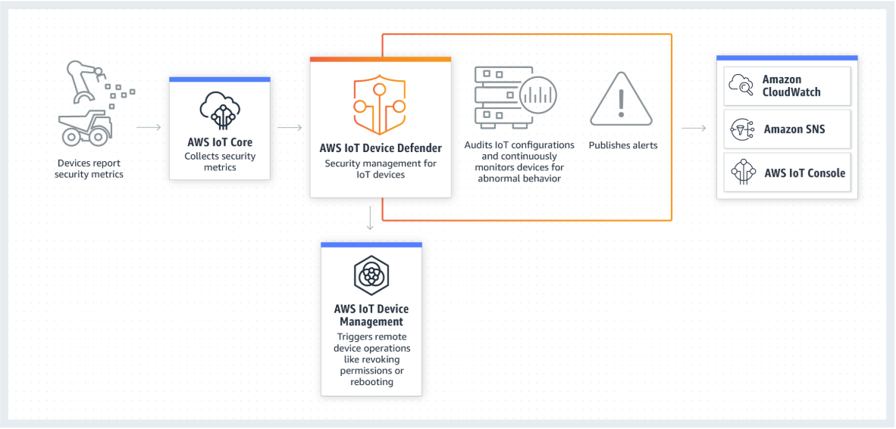
Architectural overview

Slide 14




Audit
Expiring or revoked certificates
Overly permissive policies
Device connection checks
Logging

Slide 15
Hands-on Lab: Audit your IoT Fleet
Module 1: Environment build
Module 2: Audit devices configuration
Github link to the workshop here

Slide 16




Module 1: Environment Setup
A pre-provisioned IoT device
A temporary AWS account
A configured IoT Thing that sends data to AWS IoT Core
An AWS Identity and Access Management (IAM) user

Slide 17


Definitions
IoT device – The physical IoT device out on the world
AWS IoT thing – A representation of a specific device or logical entity
Physical device or sensor
Logical entity like an instance of an application
AWS IoT topic– A JSON document used to store and retrieve current state information
Get and set the state of a device, regardless of immediate connectivity

Slide 18
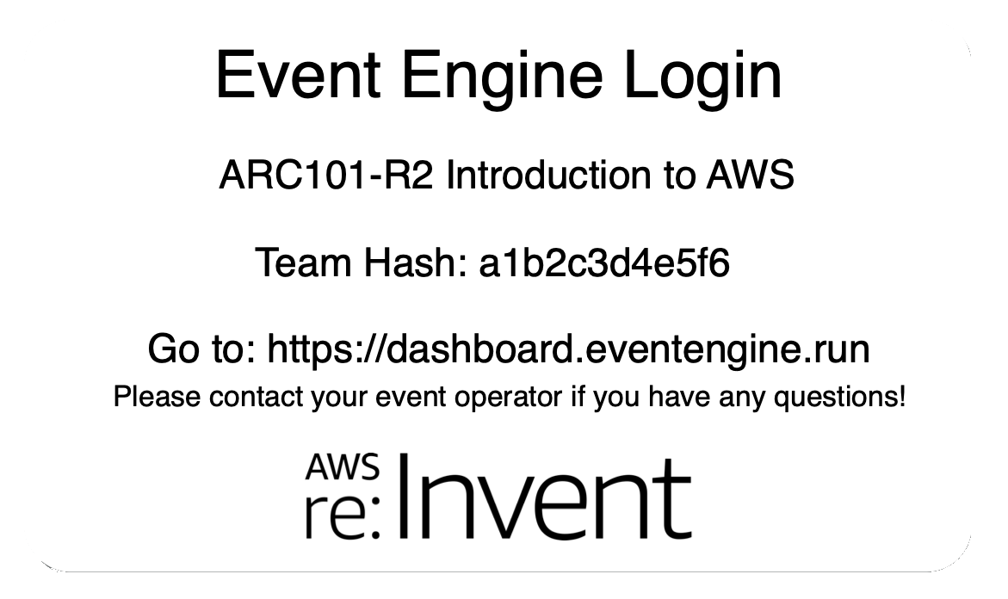
AWS Event Engine
https://dashboard.eventengine.run
The AWS Event Engine was created to help AWS field teams run Workshops, GameDays, Bootcamps, Immersion Days, and other events that require hands-on access to AWS accounts.
Notes:
Go to this URL in your browser

Slide 19
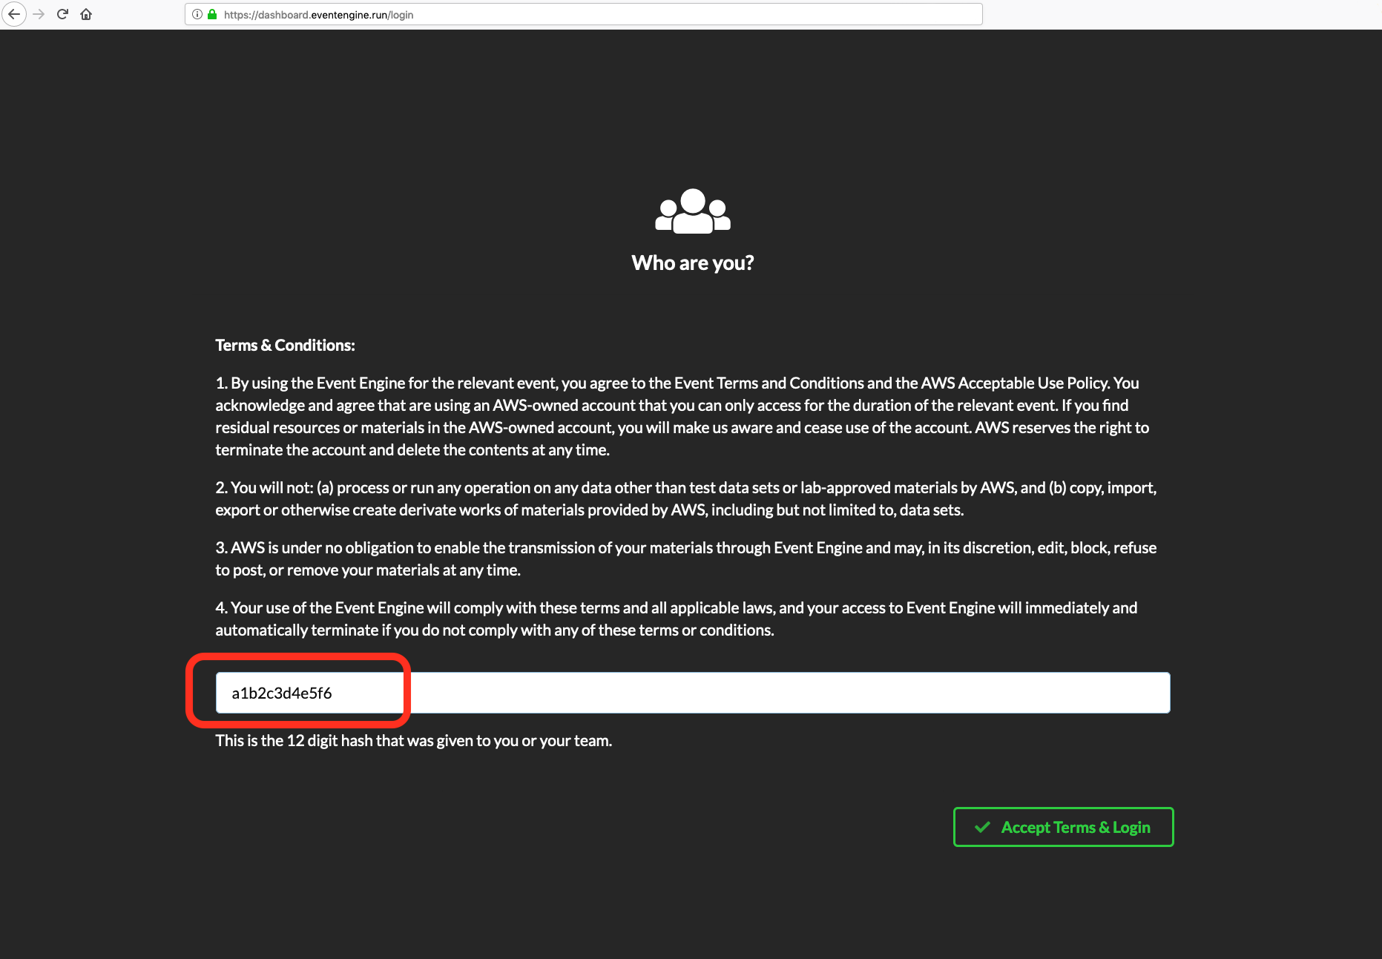
https://dashboard.eventengine.run
Notes:
You should be given a 12-character “hash” – this might be individual to you, or your team or group may share one hash.

Slide 20
walk through module 2

Slide 21
Module 2: Audit your IoT Fleet
Github link here

Slide 22
Rule 4: have a strategy to detect compromised deviced

Slide 23
Rule 5: Use automation to remediate compromised devices
Over The Air update – IoT Device Management
Lambda function

Slide 24
What should be included in Security Solutions?
Prevent
Detect
Respond
Best practices
Notes:
In this workshop we will focus on Detect and Respond

Slide 25
Anomaly Detection - Denial of Service
1001
+
+
+
Packets out
Number of Ports and/or
Suspicious port communication
Communication with suspicious IP addresses
Bytes out
Notes:
Communication with victim IP address or suspicious command and control destinations

Slide 26
Anomaly Detection – Cloud infrastructure abuse
+
+
Message rate
Message size
Communication from suspicious Source IPs

Slide 27
Module 3: Detect and response to a compromised device
Github link

Slide 28
AWS IoT Device Defender
Detect
Alert
Investigate
Mitigate

Slide 29



Security profile
1001
Packets
Bytes
Message rate
Message size
IP Destination
Source IP
Connection metrics
Authorization failures
TCP Connections
Ports
Security profile
Device-side metrics
Cloud-side metrics

Slide 30
Module 4: Receive alerts in real-time
Github link here

Slide 31
Q&A

Slide 32
Thank you

